Slide 1

Network Fundamentals
By: Aidan Fetter

Slide 2
Network Devices
A ______ is a layer 2 (or 3) device used to connect nodes that want to connect to a network and transmits data from the source port only to the destination port. This device can also:
Isolate data transmission to specific devices
Connect several devices
switch
A _________ is a layer 1 device that contains only 2 ports that transform incoming signals into outgoing signals and transmits it to the destination. This device can also:
Strengthen the weak signals to enable transmission to longer distances
Modify the signals that are created between two LANs
repeater

Slide 3
Network Devices (Part 2)
The difference between a _____ and a router is that a _____ had less ports and works in layer 2 as opposed to layer 3 (this device can be used for LAN-to-LAN connections).
bridge bridge
If I only have one device that I want connected to the internet via ethernet port, what device should I use?
A modem
I have malicious packets being sent to my network because I didn’t set up any security measures! What can I implement to block specific traffic so this doesn’t happen to anyone else?
A Firewall

Slide 4
Network Devices (Part 3)
hub
A ____ is a layer 1 device that connects computers that want to connect to the network by acting as a broadcaster from one port to all other ports in the network. This device:
Transmits data through electrical signals
Does not perform packet filtering or addressing functions
Is best suited for LAN environments
A ______ sends data in the form of packets and uses IP addresses for data transmission
router
Missing one?

Slide 5
TCP/IP Model
4-Layer Model: 5-Layer Model:
1. Network Access Layer
1. Physical Layer
2. Data-Link Layer
2. Internet Layer
3. Network/Internet Layer
3. Transport Layer
4. Transport Layer
4. Application Layer
5. Application Layer

Slide 6
IP Addresses
IPv4
IP classes
Subnet masks
Private networks
IPv6

Slide 7
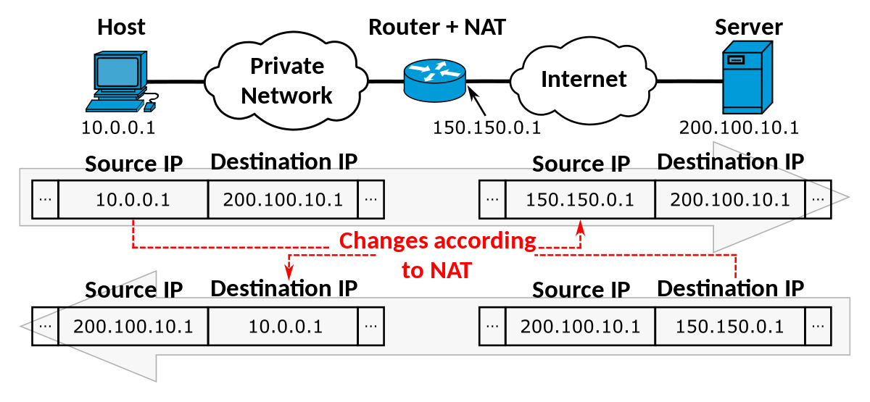
Network Address Translation (NAT)
Purpose?
NAT tables?
Advantages and disadvantages of NAT?

Slide 8
Resources
https://app.letsdefend.io/training/lessons/network-fundamentals
https://www.techtarget.com/searchsecurity/feature/The-five-different-types-of-firewalls
https://www.geeksforgeeks.org/tcp-ip-model/#
https://www.guru99.com/tcp-ip-model.html#3
Next up…
Network Protocols!

